Slide 1
CSE 228 – Principles of Artificial Intelligence
Module #3, Lecture #3

Slide 2
Contents
Constraint Satisfaction Problems

Slide 3
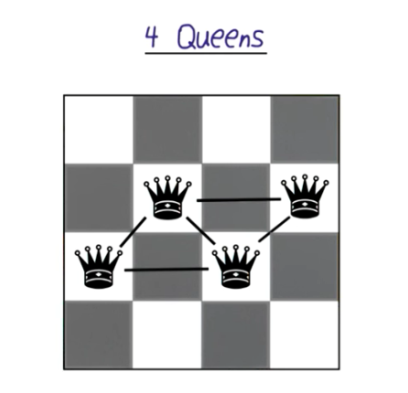
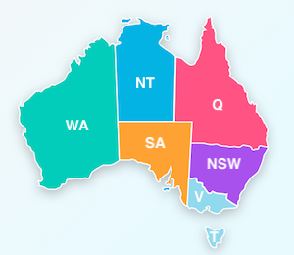
Constraint Satisfaction Problem
A constraint satisfaction problem is defined mathematically as
a set of variables,
a set of domains for each variable,
and a set of constraints
that limit which values in each domain are a valid assignment for each variable.

Slide 4
Example: Sudoku CSP Definition
Variables: The 81 cells that are assigned a value
Domain: Every variable is a single digit between 1 and 9
Constraints: Each row, column, and 3x3 box, must contain one of each of the digits from 1 to 9

Slide 5
Example: 4-Queen’s Problem CSP Definition
Variables: The row assignment of each of the 4 queens (the variables represent the queen assigned to each of the four columns)
Domains: every variable has the same domain, the single digits 1-4
Constraints: No pair of queens can be on the same row or diagonal

Slide 6
Example: Map Colouring CSP Definition
Variables: One variable for each region of the map.
Domains: All variables have the same domain – the list of permissible colours.
Constraints: No pair of adjacent regions can have the same colour.

Slide 7
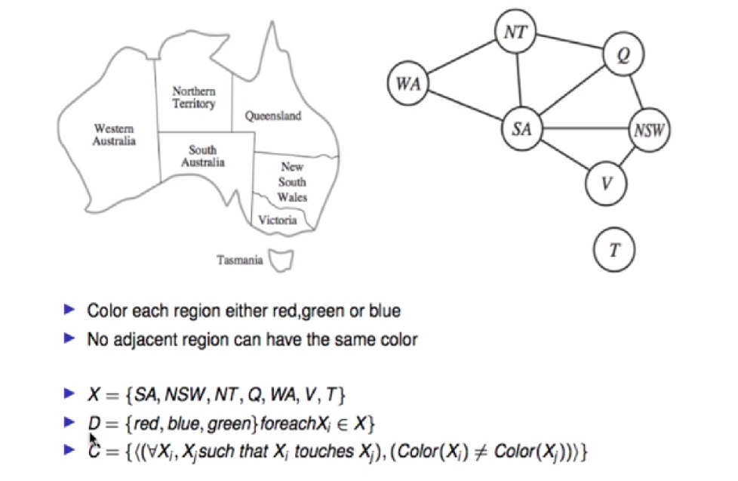
Constraint Graph

Slide 8
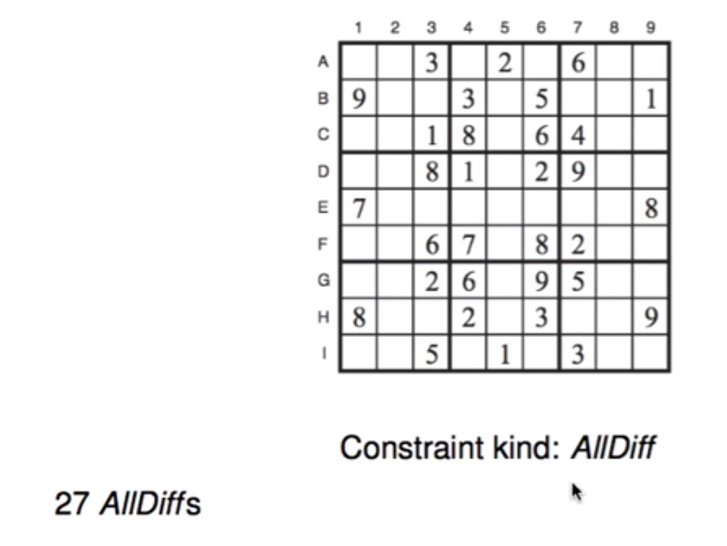
Sudoku

Slide 9
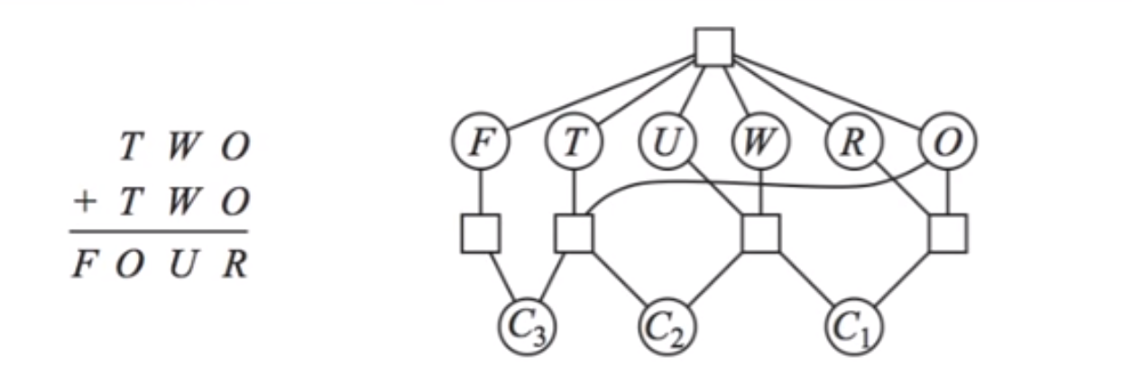
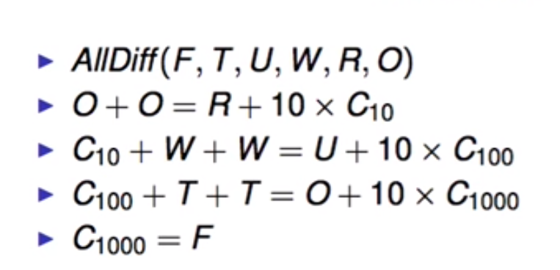
Cryptarithmetic Puzzle
Constraints???

Slide 10
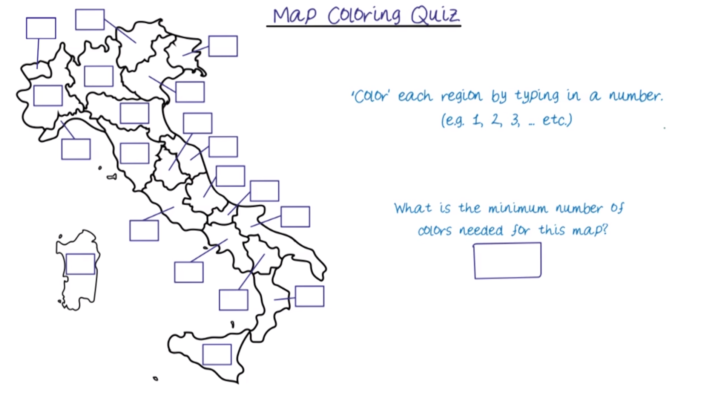

Slide 11
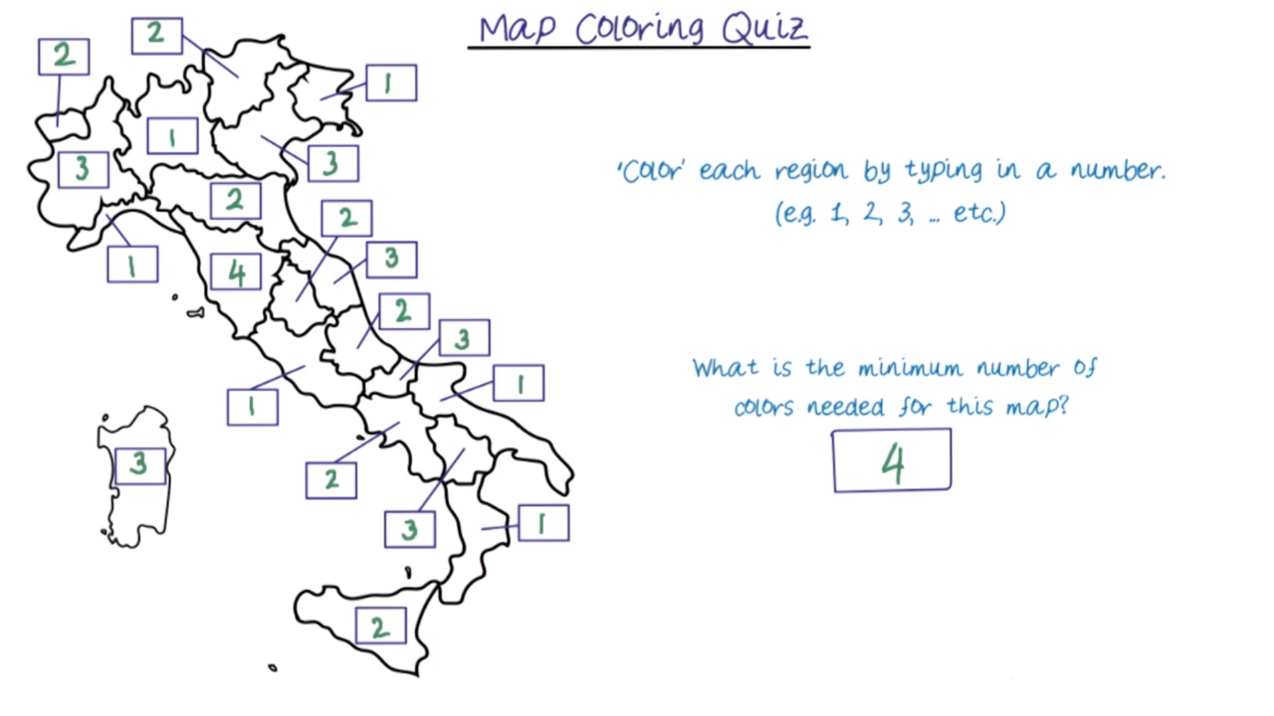

Slide 12
Types of Constraints
Types:
Unary
Binary
Constraints involving 3 or more variables
Soft Constraints
Constraint Optimization Problems
Solved using LPP

Slide 13
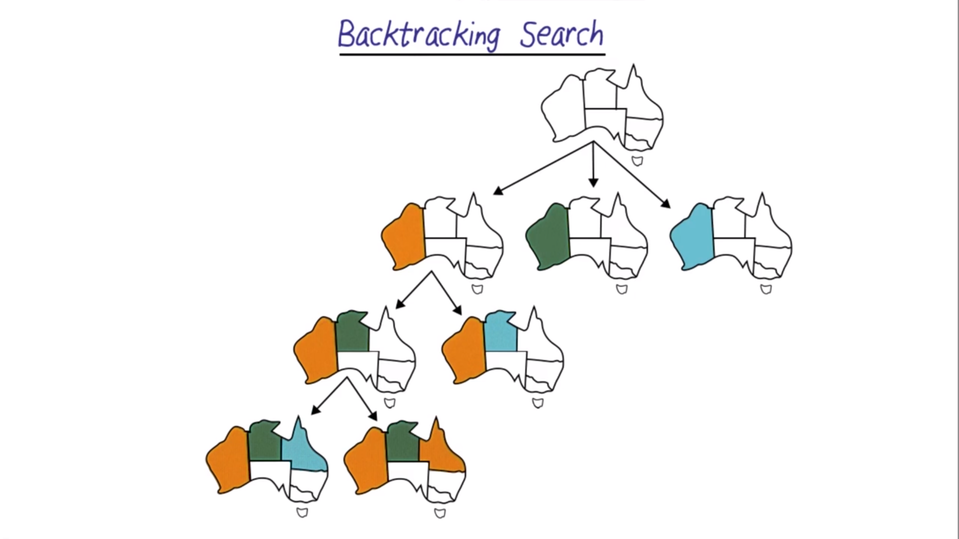

Slide 14
Optimizing Backtracking
How to choose next variables:
Degree heuristic: assign a value to the variable that is involved in the largest number of constraints on other unassigned variables.
Minimum remaining values (MRV): choose the variable with the fewest possible values.
Least-constraining value heuristic: choose a value that rules out the smallest number of values in variables connected to the current variable by constraints.
Forward Checking: Keep track of all permissible values for variables

Slide 15
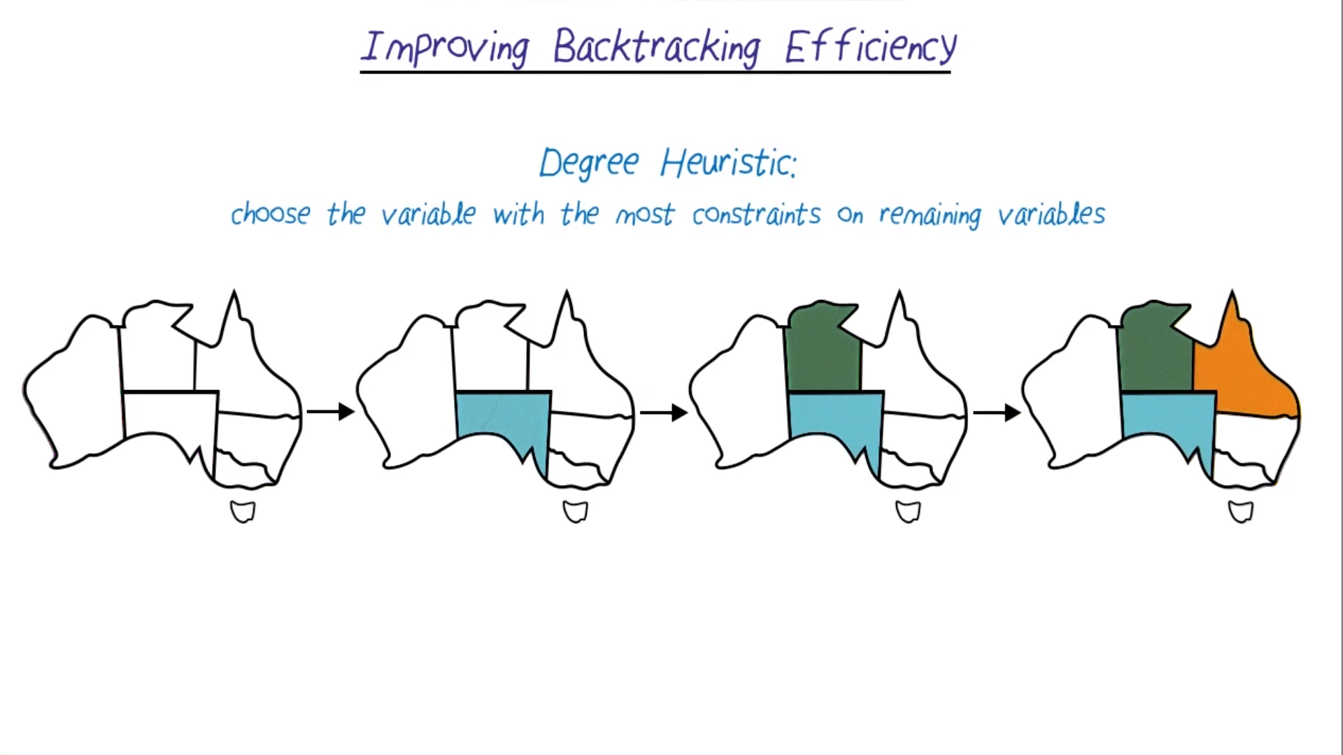

Slide 16
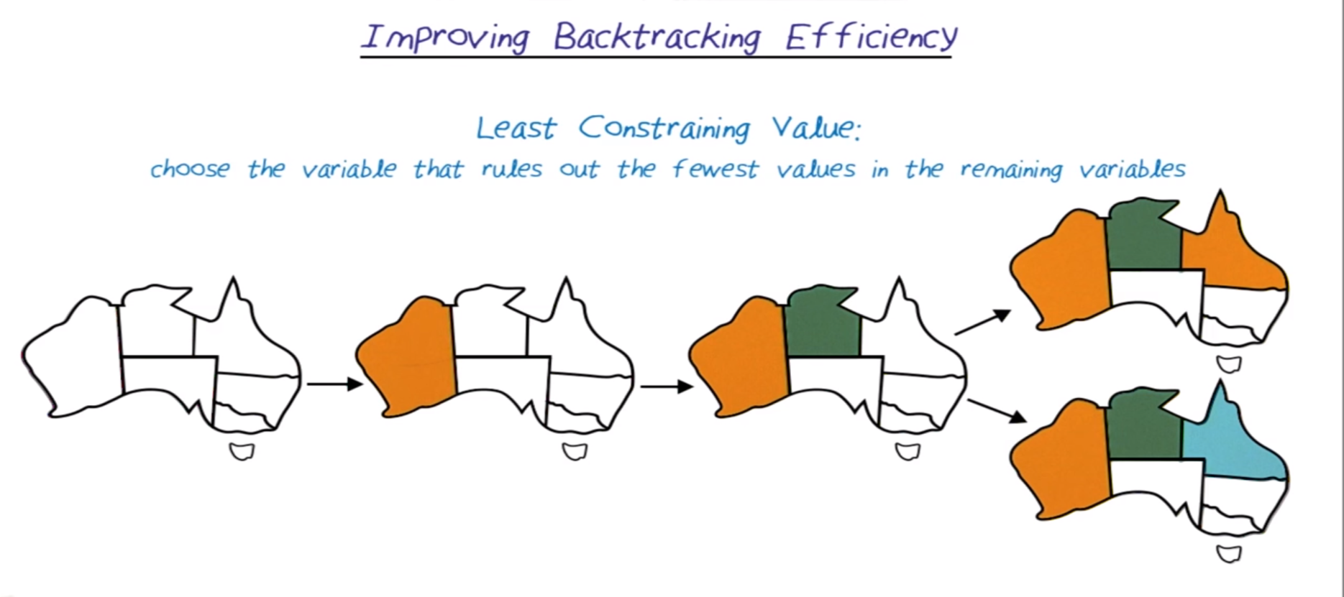
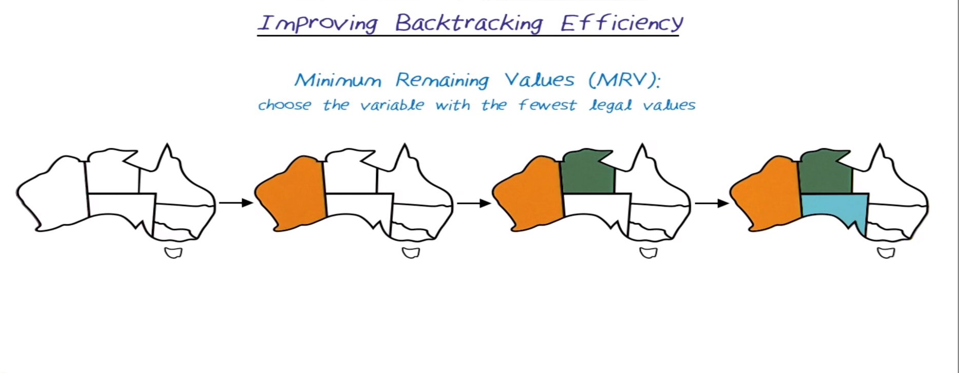

Slide 17
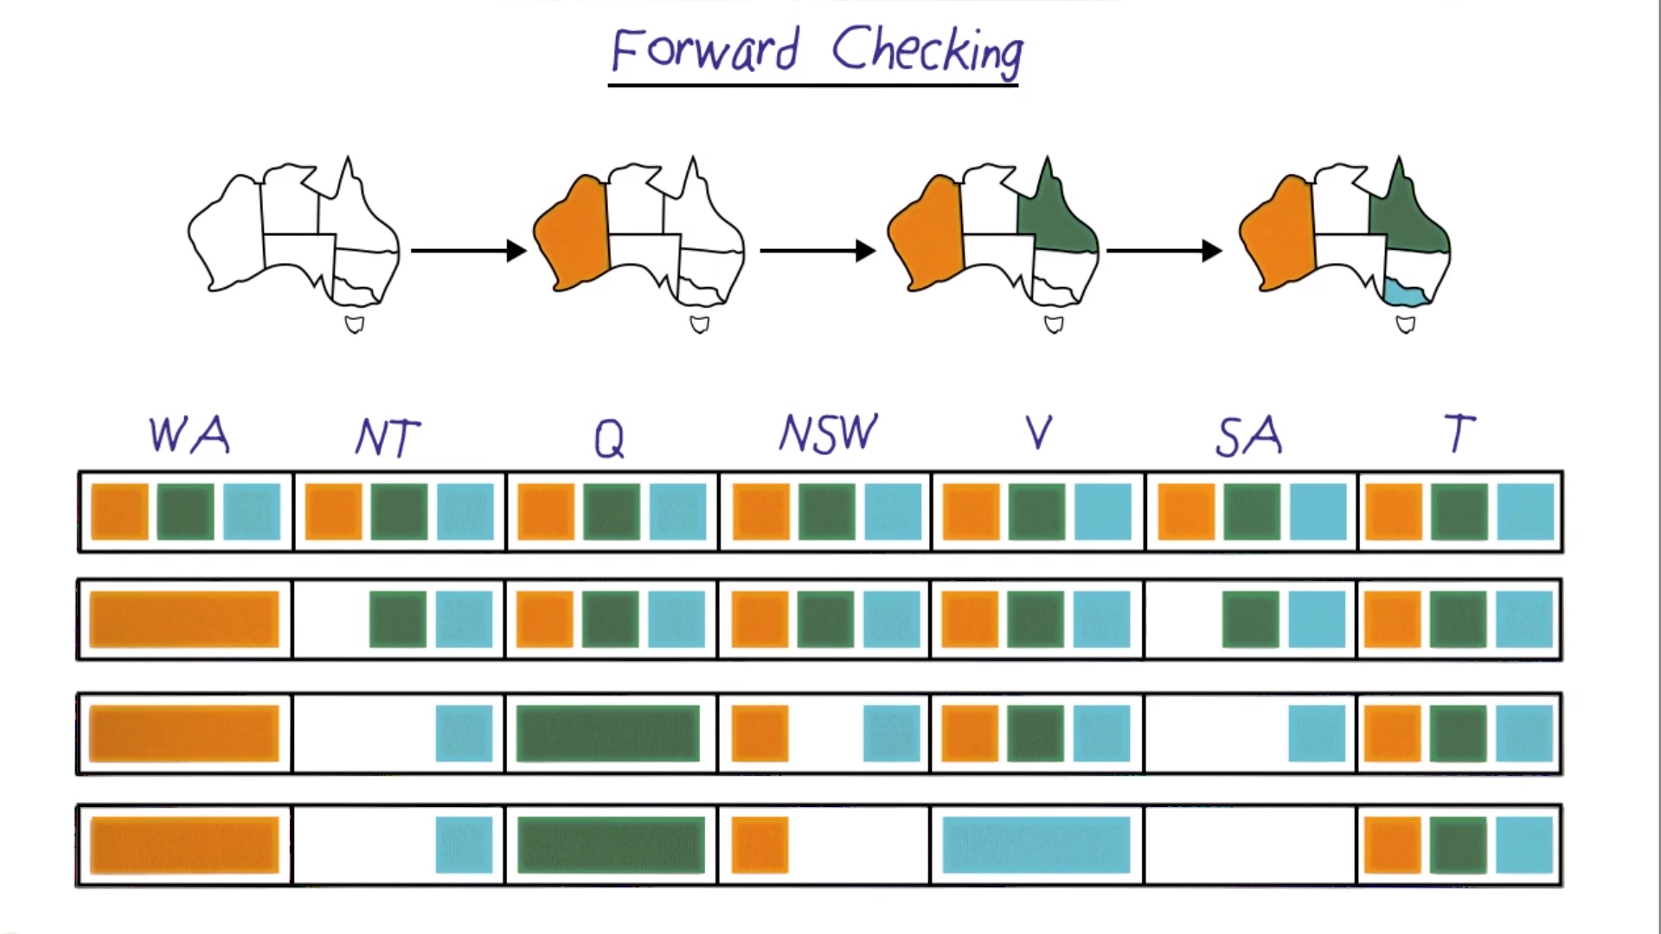
Keep track of remaining legal values for unassigned variables
■ Terminate search when any variable has no legal values

Slide 18
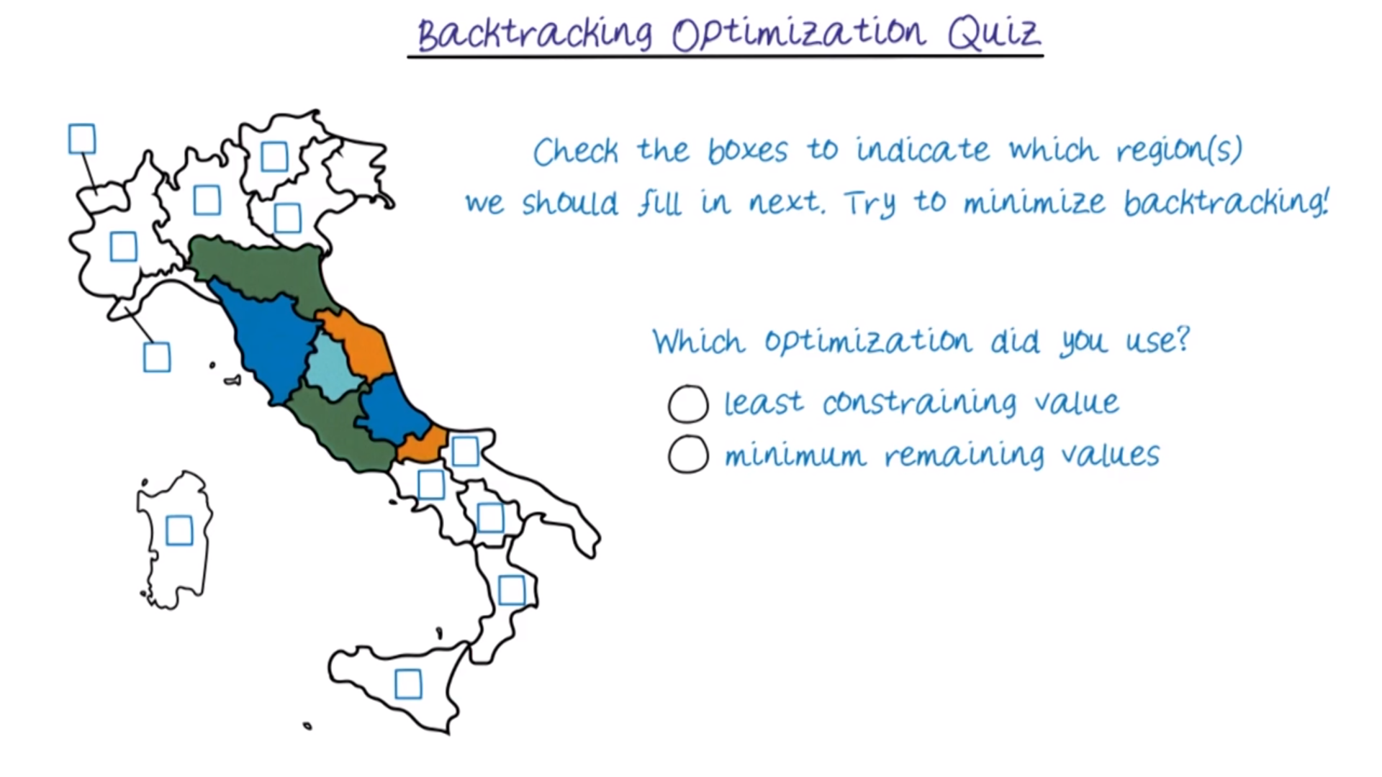

Slide 19
“You are given a 5 litre jug and a 3 litre jug. Both the jugs are initially empty. The jugs don’t have markings to allow measuring smaller quantities. You have to use the jugs to collect 4 litres of water.”
Solve the water jug problem given below using BFS. Specify the state space, the rules applied and the final solution.

Slide 20
Rules
Fill(3), Fill(5) – Fill the 3 litre / 5 litre jug to the brim.
Empty(3), Empty(5) – Empty the 3 litre / 5 litre jug.
Pour(3,5) – Pour as much water from the 3 litre jug to the 5 litre jug, till either the 3 litre jug is empty or 5 litre jug is full.
Pour(5,3) – Pour as much water from the 5 litre jug to the 3 litre jug, till either the 5 litre jug is empty or the 3 litre jug is full.

Slide 21
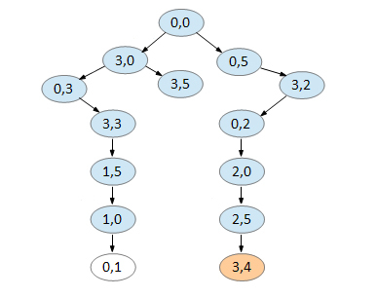
Search Space
0,0
3,0
0,5
0,3
3,5
3,2
3,3
0,2
1,5
2,0
1,0
2,5
0,1
3,4
3,1
0,4

Slide 22
Celebrity Guest Problem
You need to find a Celebrity guest (C) in a party of n guests, GIVEN that there is at least 1 celebrity guest. This is done by asking a guest A if he knows B.
The guest C is one who all the other guests know, but who does not know any of the other guests.

Slide 23
Celebrity Guests Constraints
1. For all (Xi != C), Xi knows C
2. For all (Xi != C), C !know Xi
The celebrity guest is to be found in a total of at most n-1 questions.

Slide 24
Celebrity Guest Solution
Ask guest A if he knows guest B.
If A knows B, then A != C.
If A !know B, then B != C.
Continue searching until you find C.

Slide 25
Knight’s (Closed) Tour Problem Constraints
N > 2
N > 3
N > 4
N > 5
N % 2 == 0
(RowDiff(old, new) == 2 && ColDiff(old, new) == 1) || (RowDiff(old, new) == 1 && ColDiff(old, new) == 2)

Slide 26
Knight’s (Closed) Tour Constraints
N > 5
N % 2 == 0
(RowDiff(old, new) == 2 && ColDiff(old, new) == 1) || (RowDiff(old, new) == 1 && ColDiff(old, new) == 2)

Slide 27
Prof. Eugene Freunder’s Talk on The Ubiquity of Constraints
Excellence Research Award Session – IJCAI-PRICAI2020 (ijcai20.org)

Slide 28
Back-Up Slides

Slide 29
N = 4
Knight
 |  | Knight
 | Knight
 |  |  | Knight

Slide 30
N = 5
Knight |  |  |  | Knight
 |  | Knight
 | Knight |  | Knight
 |  | Knight
Knight |  |  |  | Knight

